Slide 1
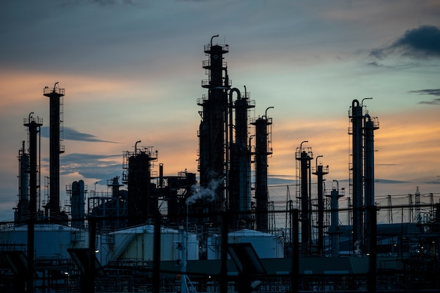
Pragya
Harshal
Michelle
Abhishek
Rock Flow Dynamics
Optimizing FLUID Transportation PLAN USING LINEAR PROGRAMMING MODEL
2023-12-06

Slide 2











Problem Understanding
Company Background:
Rock Flow Dynamics is an influential player in the Oil and Gas sector, engaging across all three integral phases of the industry: upstream, midstream, and downstream operations
Objective:
With different options available for oil transportation, Rock Flow Dynamics navigates through multiple choices to optimize the movement of resources from production to processing locations
Challenges:
01
Upstream
Production Phase
Midstream
02
Avoid Processing monopoly Only 50% of the total production from one production location should be sent for processing to another processing location (Avoid processing monopoly of a particular vendor)
Diversified Transportation Max. 20% of production from a location is transferred to one processing unit in a single mode. (Ensures flexibility and continuity in case of any mode-related disruptions)
Transportation Plan
Limited Storage Must ensure that all the produced fluid are transferred to processing unit as the storage capacity is limited
03
Downstream
Processing and Selling

Slide 3
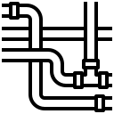




Modelling Approach
Index:
i ꞓ {1,2,3} : Index to represent production location
j ꞓ {1,2,3} : Index to represent processing location
k ꞓ {1,2,3} : Index to represent transportation type
l ꞓ {1,2,3,4} : Index to represent different outcomes post fluid extraction (sulfur, water, natural gas, crude oil)
Input Parameter:
$P_{i}$: Total production of location i
$O_{i}$: % of crude oil production in location i
${PD}_{il}$: % of different outcomes type l in the production in location i
$C_{i}$: Fluid production cost per barrel in location i
$D_{ij}$: Distance between production and processing locations i and j
${CP}_{k}$​: CPM per barrel in transportation type k.
${CH}_{k}$​: Fixed charge associated with transportation type k.
${TC}_{k}$​: Total capacity of transportation type k.
${PL}_{j}$: Total capacity of Process location j.
$E_{j}$: Efficiency of Process location j.
${EX}_{jl}$: Processing cost of extracting different outcomes l in Process location j.
${SP}_{l}$: Selling price of different outcomes l after processing
Production
Transportation
Processing
Location 1
Truck
Location 1
Location 2
Train
Location 2
Location 3
Pipe
Location 3
Given, Distance between Production and Processing
Fixed charge
Processing Cost
Cost/barrel
Cost/mile/barrel
Efficiency
Capacity
Capacity
Capacity
Price/Barrel for processed Crude oil, Sulfur, Water & Natural Gas

Slide 4
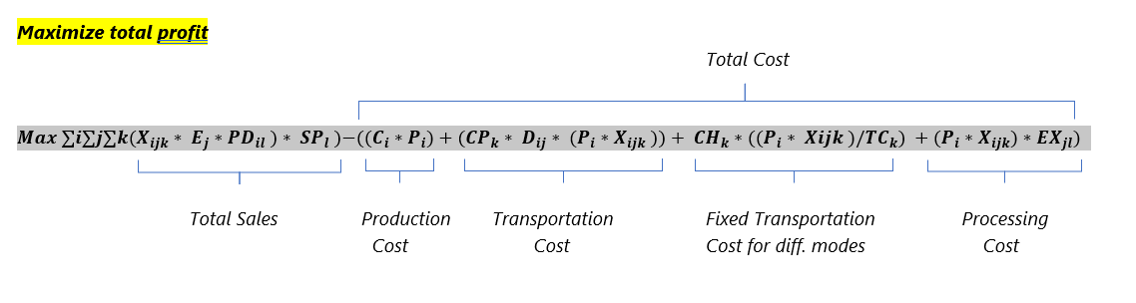
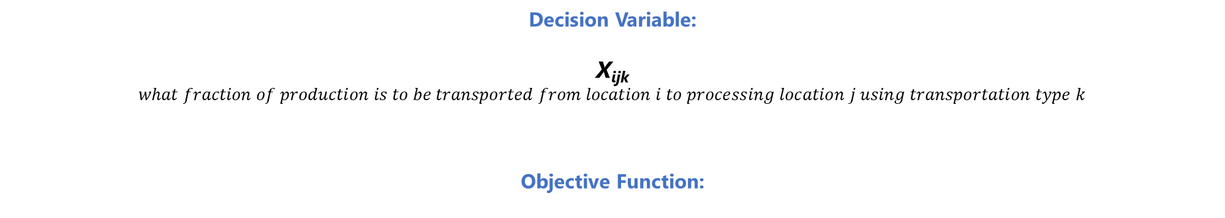
Modelling Approach
Decision Variable:
X_{ijk}
$what fraction of production is to be transported from location i to processing location j using transportation type k$
Objective Function:

Slide 5
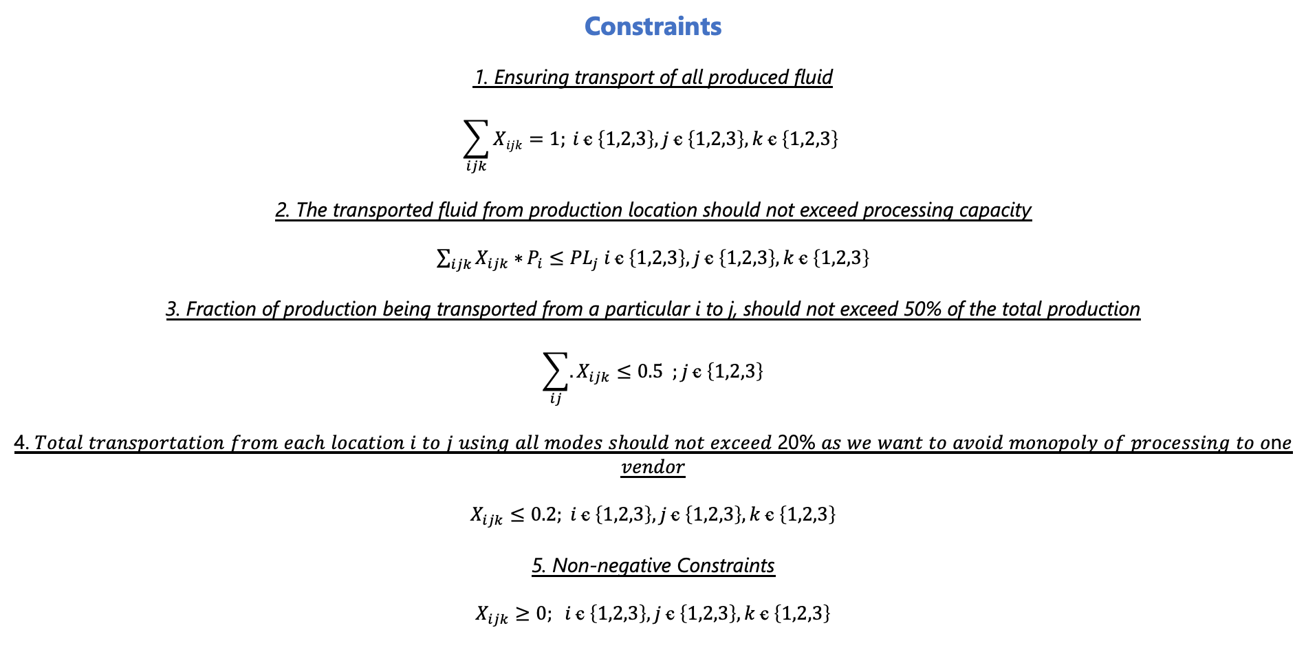
Modelling Approach
Constraints
1. Ensuring transport of all produced fluid
$$\sum_{ijk}{Xijk}=1; i ꞓ \left\{1,2,3\right\},j ꞓ \left\{1,2,3\right\},k ꞓ \left\{1,2,3\right\}$$
2. The transported fluid from production location should not exceed processing capacity
$\sum_{ijk}{X_{ijk}∗}P_{i}≤{PL}_{j} i ꞓ \left\{1,2,3\right\},j ꞓ \left\{1,2,3\right\},k ꞓ \left\{1,2,3\right\}$
3. Fraction of production being transported from a particular i to j, should not exceed 50% of the total production
$$\sum_{ij}{.}X_{ijk}≤0.5 ;j ꞓ \left\{1,2,3\right\}$$
4. 𝑇𝑜𝑡𝑎𝑙 𝑡𝑟𝑎𝑛𝑠𝑝𝑜𝑟𝑡𝑎𝑡𝑖𝑜𝑛 𝑓𝑟𝑜𝑚 𝑒𝑎𝑐ℎ 𝑙𝑜𝑐𝑎𝑡𝑖𝑜𝑛 𝑖 𝑡𝑜 𝑗 𝑢𝑠𝑖𝑛𝑔 𝑎𝑙𝑙 𝑚𝑜𝑑𝑒𝑠 𝑠ℎ𝑜𝑢𝑙𝑑 𝑛𝑜𝑡 𝑒𝑥𝑐𝑒𝑒𝑑 20% 𝑎𝑠 𝑤𝑒 𝑤𝑎𝑛𝑡 𝑡𝑜 𝑎𝑣𝑜𝑖𝑑 𝑚𝑜𝑛𝑜𝑝𝑜𝑙𝑦 𝑜𝑓 𝑝𝑟𝑜𝑐𝑒𝑠𝑠𝑖𝑛𝑔 𝑡𝑜 𝑜n𝑒 𝑣𝑒𝑛𝑑𝑜𝑟
$$X_{ijk}≤0.2; i ꞓ \left\{1,2,3\right\},j ꞓ \left\{1,2,3\right\},k ꞓ \left\{1,2,3\right\}$$
5. Non-negative Constraints
$X_{ijk}≥0; i ꞓ \left\{1,2,3\right\},j ꞓ \left\{1,2,3\right\},k ꞓ \left\{1,2,3\right\}$

Slide 6
Model Results & Recommendation
Optimized fraction of fluid to be transported via different modes
 | Truck | Train | Pipeline | Total
Location 1-1 | 0 | 0.2 | 0.1 | 0.3 | 1
Location 1-2 | 0 | 0.2 | 0.2 | 0.4
Location 1-3 | 0 | 0.1 | 0.2 | 0.3
Location 2-1 | 0 | 0 | 0 | 0 | 1
Location 2-2 | 0.1 | 0.2 | 0.2 | 0.5
Location 2-3 | 0.1 | 0.2 | 0.2 | 0.5
Location 3-1 | 0 | 0.06 | 0.1 | 0.16 | 1
Location 3-2 | 0 | 0.14 | 0.2 | 0.34
Location 3-3 | 0.1 | 0.2 | 0.2 | 0.5
Maximized Revenue based on fraction determined
 | Sulfur | Water | Natural Gas | Crude Oil | Total
Processing Location 1 | $ 2,28,160 | $ 3,122 | $ 3,88,087 | $ 3,33,455 | $ 9,52,823
Processing Location 2 | $ 6,95,315 | $ 11,596 | $ 11,96,951 | $ 9,47,767 | $ 28,51,628
Processing Location 3 | $ 8,08,068 | $ 12,777 | $ 13,95,523 | $ 9,89,477 | $ 32,05,845
Total | $ 17,31,542 | $ 27,495 | $ 29,80,561 | $ 22,70,699 | $ 70,10,296
Profit : $60,36,449
Recommendation:
Among all three different transportation mode, pipeline is the most efficient one followed by Train. 6 out of 9 routes can use pipelines with full capacity i.e., 20%
Trucks are least effective mode and can be used in only 3 out of 9 different routes with half of the allowed capacity
The most preferred route for each combination of production and processing location are listed as: (Production 1 -> Processing 2) (Production 2 -> Processing 2 & 3) (Production 3 -> Processing 3)

Slide 7
Pragya
Harshal
Michelle
Abhishek
Thank You

